Slide 1

Data Mining
CS-772
Department of Computer Sciences

Slide 2
Classification
Decision Trees

Slide 3
Decision Rules
In many fields, large collections of examples, possibly collected for other purposes, are readily available.
Automatically generating classification rules (often called decision rules) for such tasks has proved to be a realistic alternative to the standard Expert System approach of eliciting the rules from experts.
Reported in literature, two large applications of 2,800 and 30,000+ rules, developed using automatic techniques in only one and 9 man-years, respectively, compared with the estimated 100 and 180 man-years needed to develop the celebrated ‘conventional’ Expert Systems MYCIN and XCON.
Notes:
MYCIN was an early expert system that used artificial intelligence to identify bacteria causing severe infections. MYCIN was developed over five or six years in the early 1970s at Stanford University written in Lisp (PhD work)
The R1 (later called XCON, for eXpert CONfigurer) program was a production-rule-based system written in OPS5 by John P. McDermottof CMU in 1978 to assist in the ordering of DEC's VAX computer systems by automatically selecting the computer system components based on the customer's requirements.

Slide 4
Decision Tree
In many (but not all) cases decision rules can conveniently be fitted together to form a tree structure

Slide 5
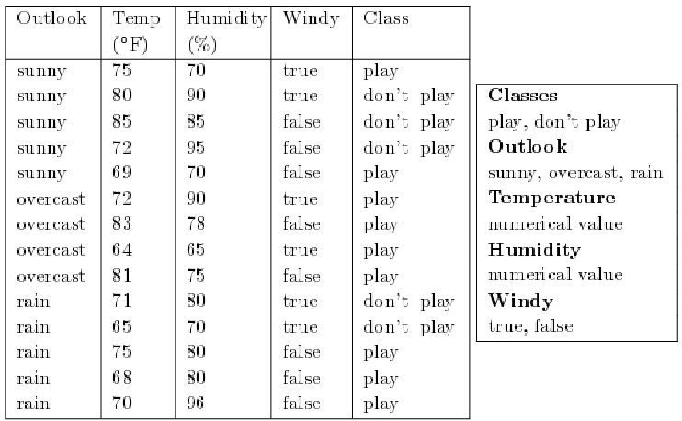
Example
Results of two weeks (14 days) of observations of weather conditions and the decision on whether or not to play golf.
Notes:
A fictitious example which has been used for illustration by many authors, is that of a golfer who decides whether or not to play each day on the basis of the weather.

Slide 6
Assuming the golfer is acting consistently, what are the rules that determine the decision whether or not to play each day? If tomorrow the values of Outlook, Temperature, Humidity and Windy were sunny, 74◦F, 77% and false respectively, what would the decision be?

Slide 7
Decision Rules
In order to determine the decision (classification) for a given set of weather conditions from the decision tree, first look at the value of Outlook. There are three possibilities.
1. If the value of Outlook is sunny, next consider the value of Humidity. If the value is less than or equal to 75 the decision is play. Otherwise the decision is don’t play.
2. If the value of Outlook is overcast, the decision is play.
3. If the value of Outlook is rain, next consider the value of Windy. If the value is true the decision is don’t play, otherwise the decision is play.
Note that the value of Temperature is never used.

Slide 8
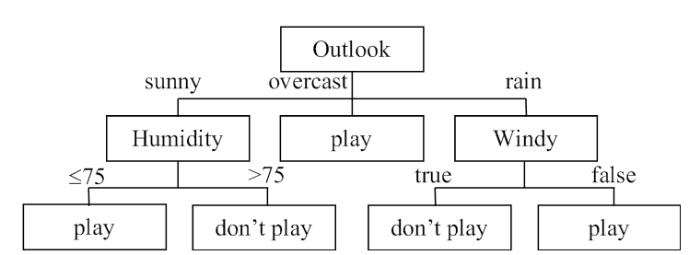
Decision Tree
The aim is to develop classification rules from the data in the training set.
This is often done in the implicit form of a decision tree.

Slide 9
Splitting of Attribute Values
A decision tree is created by a process known as splitting on the value of attributes (or just splitting on attributes), i.e. testing the value of an attribute such as Outlook and then creating a branch for each of its possible values.
In the case of continuous attributes the test is normally whether the value is ‘less than or equal to’ or ‘greater than’ a given value known as the split value.
The splitting process continues until each branch can be labelled with just one classification.

Slide 10
Decision Tree Functions
Prediction
Data compression

Slide 11
Prediction
Figure (slide 8) can be regarded simply as a more compact way of representing the data in data given in table on slide 6.
The two representations are equivalent in the sense that for each of the 14 instances the given values of the four attributes will lead to identical classifications.
The decision tree is more than an equivalent representation to the training set.
It can be used to predict the values of other instances not in the training set, for example the one given previously where the values of the four attributes are sunny, 74, 77 and false respectively.
It is easy to see from the decision tree that in this case the decision would be don’t play.
It is important to stress that this ‘decision’ is only a prediction, which may or may not turn out to be correct. There is no infallible way to predict the future!

Slide 12
Degrees Example
The training set shown in next slide (taken from a fictitious university) shows the results of students for five subjects coded as SoftEng, ARIN, HCI, CSA and Project and their corresponding degree classifications, which in this simplified example are either FIRST or SECOND.
There are 26 instances.
What determines who is classified as FIRST or SECOND?

Slide 13
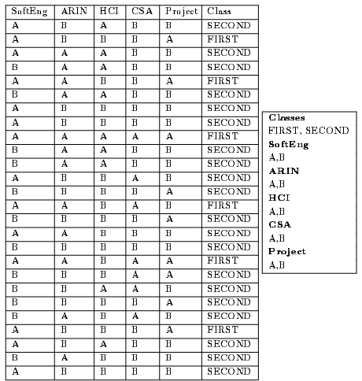
Example

Slide 14
Decision Rules
IF SoftEng = A AND Project = A THEN Class = FIRST
IF SoftEng = A AND Project = B AND ARIN = A AND CSA = A
THEN Class = FIRST
IF SoftEng = A AND Project = B AND ARIN = A AND CSA = B
THEN Class = SECOND
IF SoftEng = A AND Project = B AND ARIN = B
THEN Class = SECOND
IF SoftEng = B THEN Class = SECOND

Slide 15
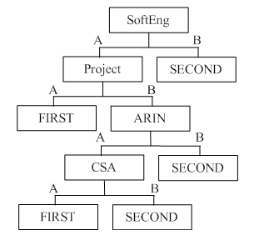
Example- Possible Decision Tree

Slide 16
Disjunctive Normal Form (DNF)
The left-hand side of each rule (known as the antecedent) comprises a number of terms joined by the logical AND operator.
Each term is a simple test on the value of a categorical attribute (e.g. SoftEng = A) or a continuous attribute
A set of rules of this kind is said to be in Disjunctive Normal Form (DNF).
The individual rules are sometimes known as disjuncts.

Slide 17
Data Compression
There are 26 such rules, one per instance, each with five terms, making a total of 130 terms.
Even for this very small training set, the reduction in the number of terms requiring to be stored from the training set (130 terms) to the decision tree (14 terms) is almost 90%.
Looking at the example in terms of data compression, the decision tree can be written as five decision rules with a total of 14 terms, an average of 2.8 terms per rule.

Slide 18
Ordering of rules
The order in which we write the rules generated from a decision tree is
arbitrary, so the five rules given above could be rearranged to (say)
IF SoftEng = A AND Project = B AND ARIN = A AND CSA = B
THEN Class = SECOND
IF SoftEng = B THEN Class = SECOND
IF SoftEng = A AND Project = A THEN Class = FIRST
IF SoftEng = A AND Project = B AND ARIN = B
THEN Class = SECOND
IF SoftEng = A AND Project = B AND ARIN = A AND CSA = A
THEN Class = FIRST

Slide 19
Practical use
The rules can easily be simplified to an equivalent nested set of IF . . . THEN . . . ELSE rules, with even more compression, e.g. (for the original set of rules)
if (SoftEng = A) {
if (Project = A) Class = FIRST
else {
if (ARIN = A) {
if (CSA = A) Class = FIRST
else Class = SECOND
}
else Class = SECOND
}
}
else Class = SECOND

Slide 20
Top-Down Induction of Decision Trees (TDIDT algorithm)`
Decision trees are widely used as a means of generating classification rules because of the existence of a simple but very powerful algorithm called TDIDT, which stands for Top-Down Induction of Decision Trees.
This has been known since the mid-1960s and has formed the basis for many classification systems, two of the best-known being ID3 and C4.5 , as well as being used in many commercial data mining packages.

Slide 21
Recursive Partitioning
The method produces decision rules in the implicit form of a decision tree.
Decision trees are generated by repeatedly splitting on the values of attributes.
This process is known as recursive partitioning.
In the standard formulation of the TDIDT algorithm there is a training set of instances.
Each instance corresponds to a member of a universe of objects, which is described by the values of a set of categorical attributes.

Slide 22
The basic algorithm can be given in just a few lines as shown in next slide.
At each non-leaf node an attribute is chosen for splitting.
This can potentially be any attribute, except that the same attribute must not be chosen twice in the same branch.
This restriction is entirely not harmful or offensive , e.g. in the branch corresponding to the incomplete rule
IF SoftEng = A AND Project = B . . . . . .
It is not permitted to choose SoftEng or Project as the next attribute to split on, but as their values are already known there would be no point in doing so
Notes:
not harmful or offensive

Slide 23
TDIDT: BASIC ALGORITHM
IF all the instances in the training set belong to the same class
THEN return the value of the class
ELSE
(a) Select an attribute A to split on+
(b) Sort the instances in the training set into subsets, one for each value of attribute A
(c) Return a tree with one branch for each non-empty subset, each branch having a descendant subtree or a class value produced by applying the algorithm recursively
+ Never select an attribute twice in the same branch

Slide 24
Adequacy Condition
There is one important condition which must hold before the TDIDT algorithm can be applied.
This is the Adequacy Condition:
no two instances with the same values of all the attributes may belong to different classes.
This is simply a way of ensuring that the training set is consistent.
A major problem with the TDIDT algorithm, which is not apparent at first sight, is that it is underspecified.
The algorithm specifies ‘Select an attribute A to split on’ but no method is given for doing this.

Slide 25

Assignment

